Slide 1
Basic Applied Cryptography

Slide 2
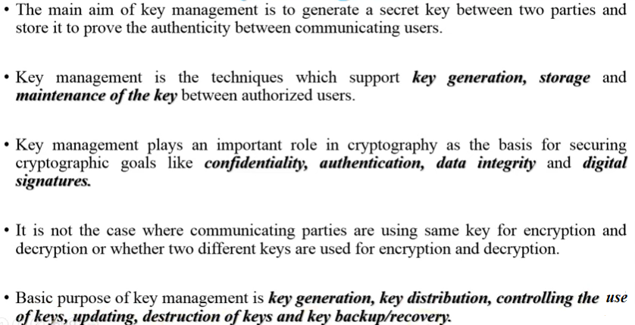


Key Management

Slide 3
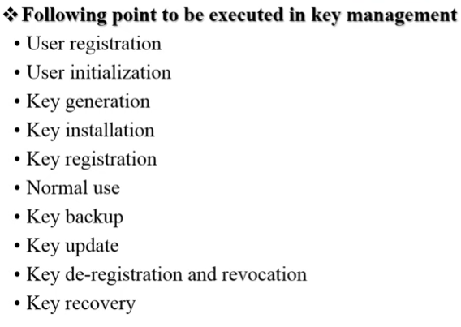

Slide 4
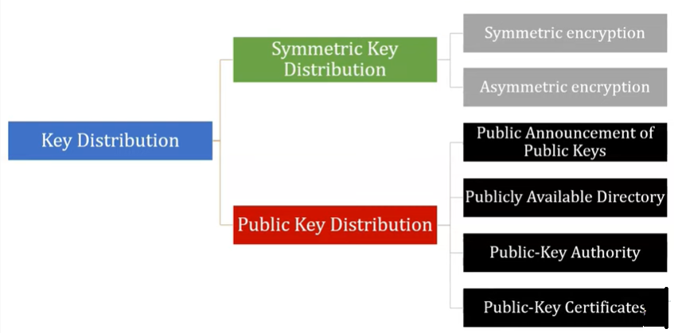
Key Distribution

Slide 5
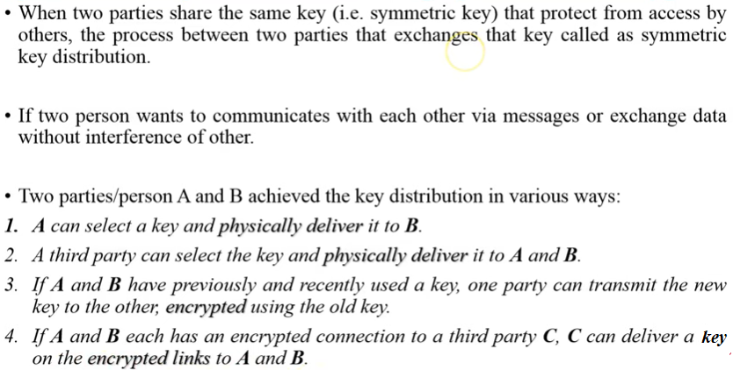
Symmetric key distribution using symmetric encryption

Slide 6
4 ways
Physical Meet
Advantage- More secured
Disadvantage- More time
Key Distribution Center (KDC)
Generate the key and send to the users involved.
Advantage – Less Time, Authentic but we should rely on the 3rd party.
Using Previous keys
We use the old keys and perform encryption and generate the new keys.
Using third party
The user A send the key to C (third party) and C will send the key to user B. Now User A and B will start communicating each other.

Slide 7
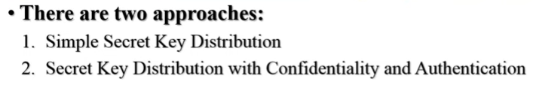
Symmetric key distribution using Asymmetric encryption

Slide 8
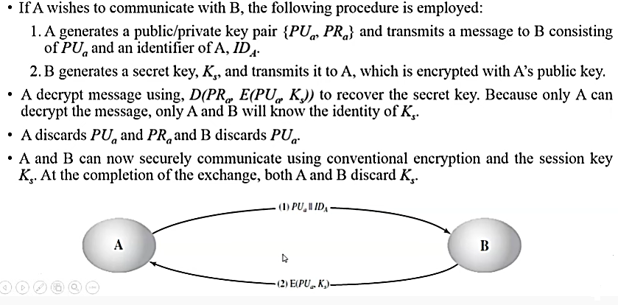
Simple Secret key Distribution

Slide 9
Disadvantage
There is no confidentiality and authentication.

Slide 10
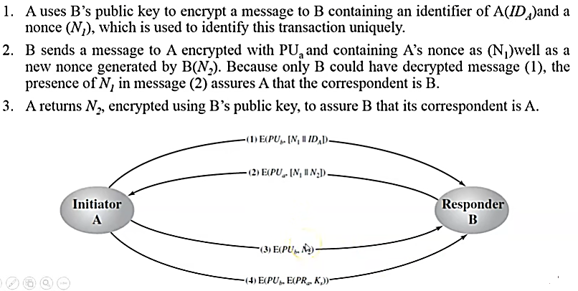
Secret key Distribution with confidentiality and Authentication

Slide 11
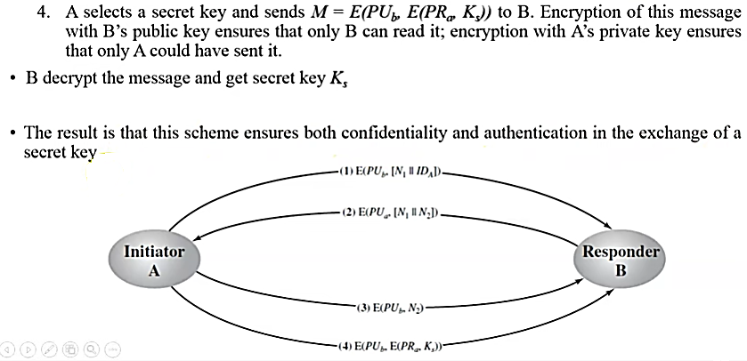

Slide 12
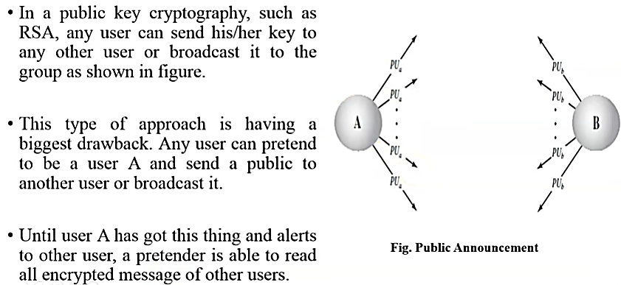
Public Key Distribution
Public Announcement

Slide 13
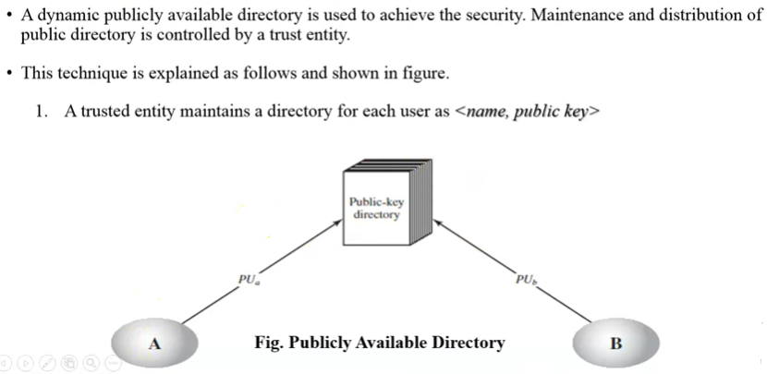
Publicly available directory

Slide 14
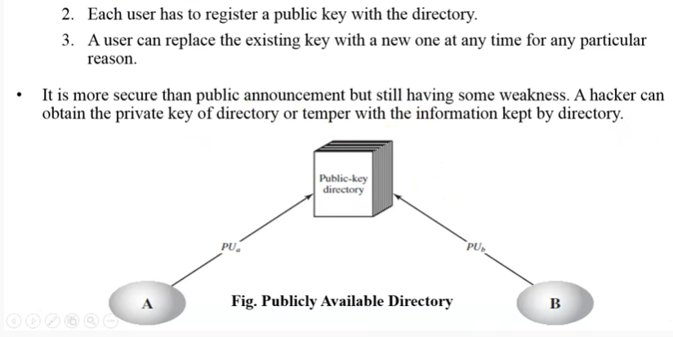
Publicly available directory

Slide 15
Disadvantage
If user B access the public key of user A from public directory and immediately user A updates the public key in the directory , It leads to some issues.
Any unauthorized person can store their public keys..

Slide 16
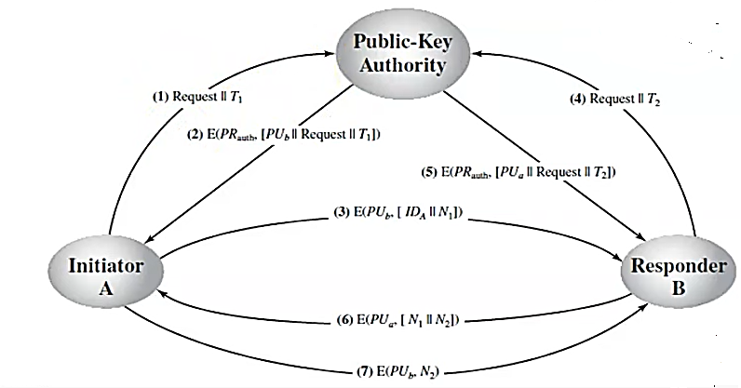
Public Key Authority

Slide 19
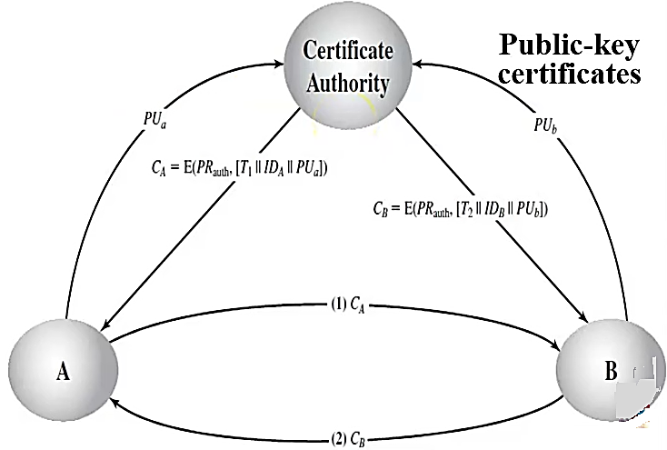
Public Key certificate Authority
Certificate authority generates certificates.
Each certificates contains the identity of the user, public key and the signature.

